Slide 1
Play store app review analysis
CAPSTONE PROJECT
Presented By:
1. Aditya Malviya, GGITS, Electrical and Electronics Engineering (EEE/EX)

Slide 2
OUTLINE
Problem Statement
Proposed System/Solution
System Development Approach
Result
Conclusion
Future Scope
References

Slide 3
Problem Statement
The Play Store apps data has enormous potential to drive app-making businesses to success. Actionable insights can be drawn for developers to work on and capture the Android market. Each app (row) has values for category, rating, size, and more. Another dataset contains customer reviews of the android apps. Explore and analyze the data to discover key factors responsible for app engagement and success.

Slide 4
Proposed Solution
Integration of Play Store Data: Outline how you'll extract and integrate Play Store data into Power BI for analysis. Discuss the tools or methods you'll use for data extraction and any challenges you anticipate.
Data Cleaning and Preprocessing: Explain the importance of data cleaning and preprocessing to ensure the quality and accuracy of the analysis. Highlight specific steps you'll take to clean the data, such as removing duplicates, handling missing values, and standardizing formats.
Sentiment Analysis: Describe how you'll perform sentiment analysis on the user reviews using Power BI. Discuss the algorithms or techniques you'll use to classify reviews into positive, negative, or neutral sentiments.
Visualization Techniques: Discuss the visualization techniques you'll employ in Power BI to showcase the findings effectively. Highlight the types of visualizations you'll use, such as bar charts, line charts, word clouds, and heatmaps, and explain how they'll help convey insights.
Interactive Dashboards: Emphasize the creation of interactive dashboards in Power BI to allow stakeholders to explore the data dynamically. Discuss the key metrics and KPIs you'll include in the dashboards to track app performance and user satisfaction over time.
Trend Analysis: Explain how you'll conduct trend analysis to identify patterns and changes in user sentiments and app ratings. Discuss the timeframe you'll analyze and how you'll visualize trends using Power BI.
Actionable Insights: Highlight the ultimate goal of the analysis—to provide actionable insights to app developers. Discuss how you'll translate the findings into actionable recommendations for improving app quality, enhancing user experiences, and driving app success.
Feedback Loop: Propose establishing a feedback loop whereby insights from the analysis inform iterative improvements to the app. Explain how you'll monitor the impact of these improvements and continuously refine the analysis process.
Scalability and Automation: Address the scalability of the solution and how you'll ensure it can handle increasing volumes of user reviews over time. Discuss any plans for automating data extraction, analysis, and reporting to streamline the process.
Benefits and ROI: Finally, summarize the benefits of implementing the proposed solution, including improved app quality, enhanced user satisfaction, and potentially increased app downloads and revenue. Discuss the expected return on investment (ROI) of leveraging Power BI for app review analysis.

Slide 5
System Approach
Welcome to our Play Store App Review Analysis project powered by Power BI! With the immense volume of user feedback on the Play Store, we leverage the analytical capabilities of Power BI to extract actionable insights and drive decision-making. By integrating Play Store data with Power BI, we unlock the potential to visualize trends, sentiment analysis, and user feedback in real-time dashboards. Through interactive reports and intuitive visualizations, we uncover patterns, sentiment trends, and emerging issues within user reviews. Utilizing Power BI's advanced analytics features, we delve into the nuances of user sentiment, identify popular features, and pinpoint areas for improvement. Join us as we harness the power of data visualization to transform raw feedback into actionable insights, empowering app developers to enhance user experiences and drive app success.

Slide 6
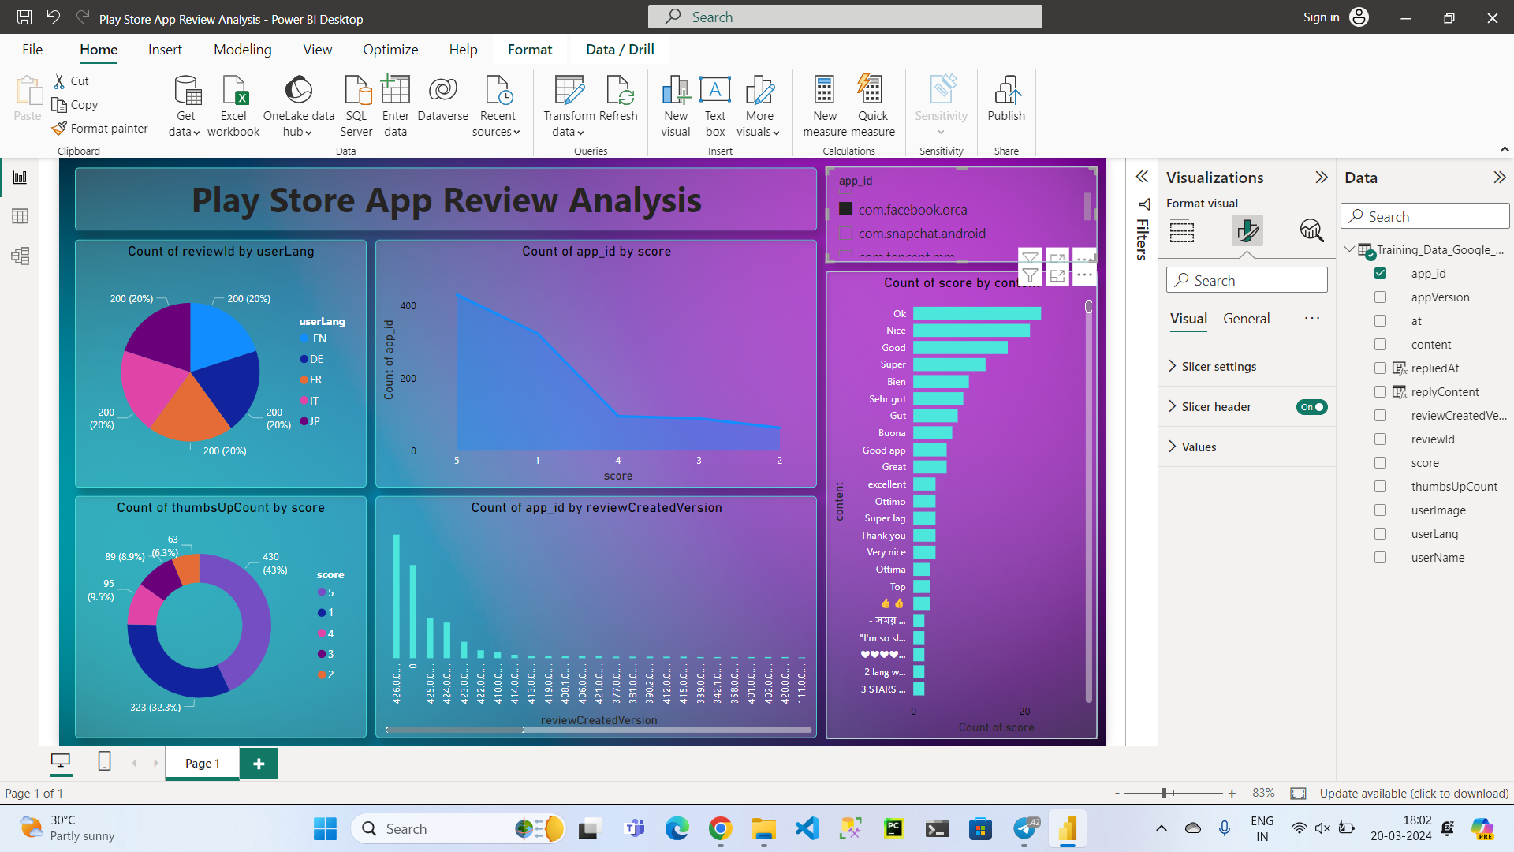
Result

Slide 7
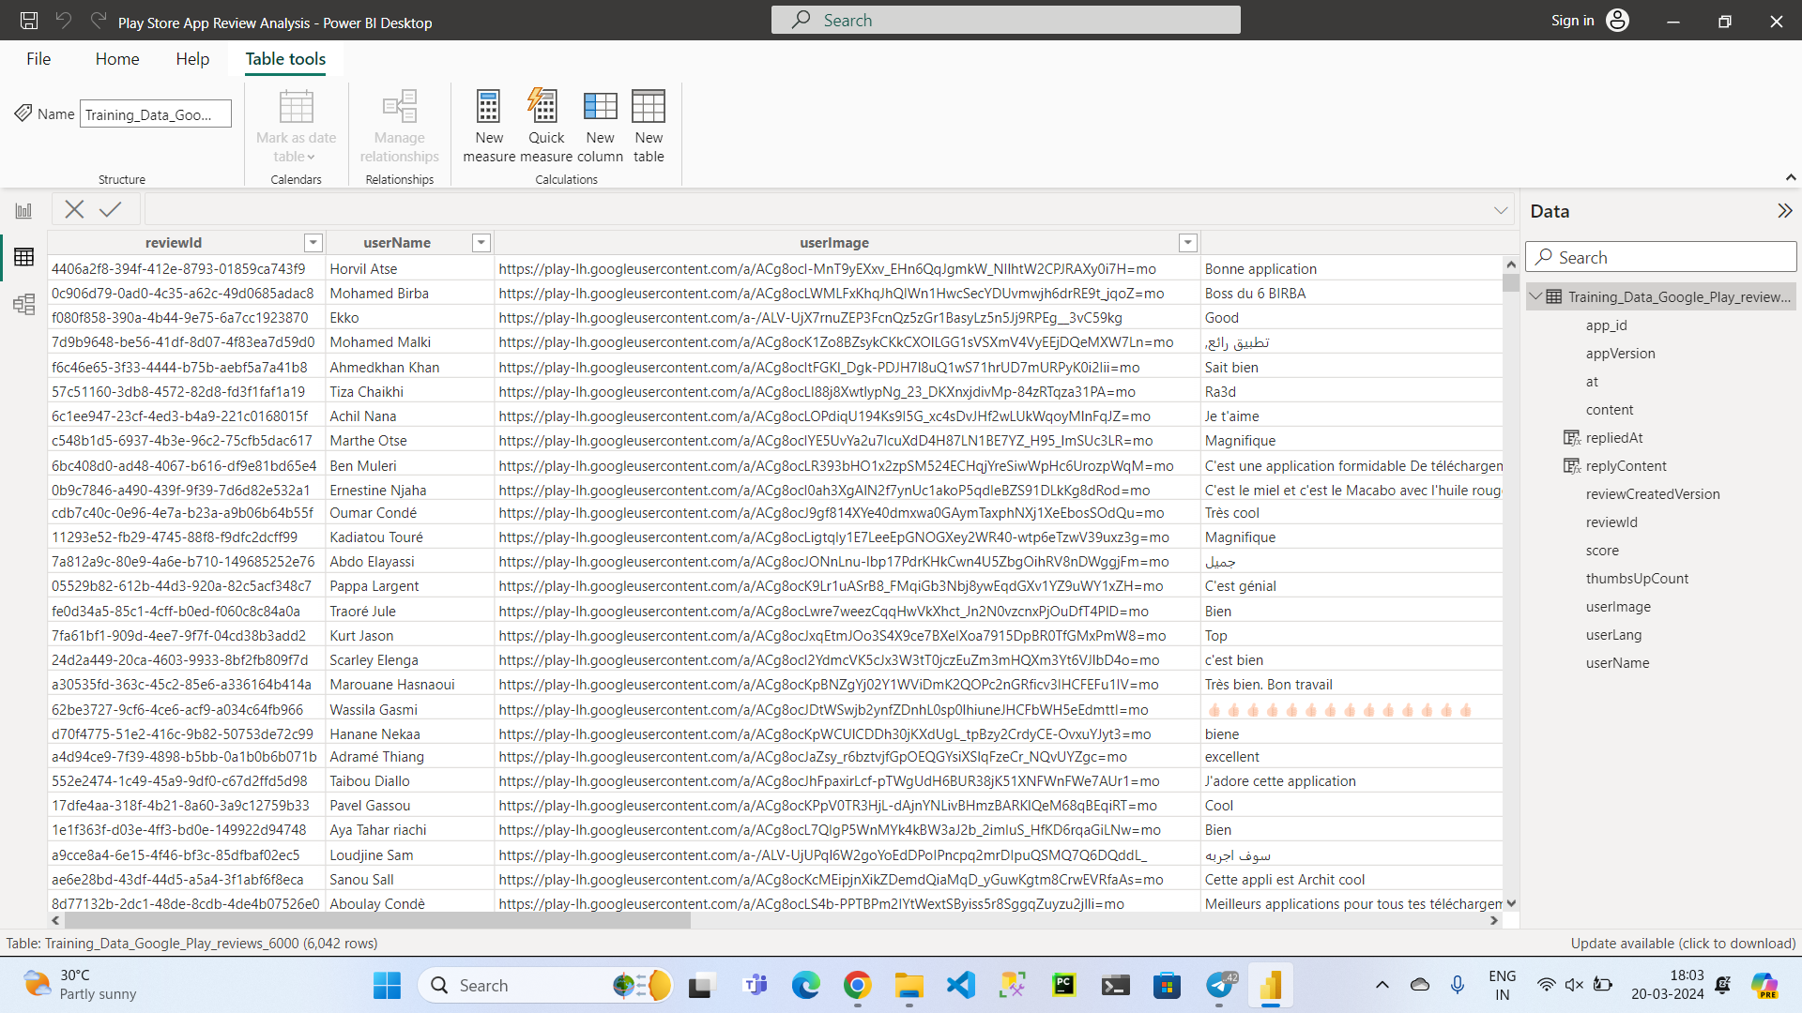

Slide 8
Conclusion
In conclusion, our Play Store App Review Analysis project, powered by Power BI, offers a robust solution for extracting actionable insights from user feedback. By integrating Play Store data into Power BI, we unlock the power of data visualization and advanced analytics to drive decision-making and improve app quality. Through sentiment analysis, trend identification, and interactive dashboards, we gain valuable insights into user sentiments, preferences, and pain points. The proposed solution not only empowers app developers to make informed decisions for enhancing user experiences but also establishes a feedback loop for continuous improvement. As we embark on this journey, we are poised to revolutionize the way app developers harness the voice of their users to drive app success. Together, let's leverage the power of data to create impactful experiences and drive innovation in the world of mobile applications.

Slide 9
Future scope
In the future, our Play Store App Review Analysis project holds immense potential for expansion and enhancement. We aim to integrate advanced machine learning models for sentiment analysis, extend analysis to support multiple languages and social media platforms, and incorporate predictive analytics to forecast trends and recommend preemptive actions. Additionally, we plan to include user engagement analytics, competitive analysis, real-time monitoring, feedback integration, user segmentation, and cross-platform analysis. These initiatives will enable us to provide more comprehensive insights, tailored recommendations, and personalized experiences, ultimately driving continuous innovation and improvement in app quality and user satisfaction.

Slide 10
References
Ferrari, M., Russo, A., & Webb, C. (2018). Analysing Data with Power BI and Power Pivot for Excel. Microsoft Press.
Clark, R., & Martens, T. (2020). Mastering Power BI: Expert techniques for effective data analytics and business intelligence. Packet Publishing Ltd.
Enridge, D. (2019). Microsoft Power BI Quick Start Guide: Build dashboards and visualizations to make your data come to life. Packet Publishing Ltd.
Singh, R., & Kurita, A. (2018). Microsoft Power BI Cookbook: Creating Business Intelligence Solutions of Analytical Data Models, Reports, and Dashboards. Packet Publishing Ltd.
Ferrari, M., Russo, A., & Webb, C. (2018). Analysing Data with Power BI and Power Pivot for Excel. Microsoft Press.
Freeman, D., & Freeman, D. (2018). Power BI: The Ultimate Guide to Learn Power BI for Business Intelligence. Independently Published.
McKellar, J., & Singh, R. (2020). Mastering Microsoft Power BI: Expert techniques for effective data analytics and business intelligence. Packet Publishing Ltd.
Deracinate, F. (2018). Microsoft Power BI Quick Start Guide: Build dashboards and visualizations to make your data come to life. Packet Publishing Ltd.
Singh, R., & Kurita, A. (2018). Microsoft Power BI Cookbook: Creating Business Intelligence Solutions of Analytical Data Models, Reports, and Dashboards. Packet Publishing Ltd.
Baroques, S. (2018). Power BI Essentials: An introduction to Microsoft Power BI. Independently Published.

Slide 11
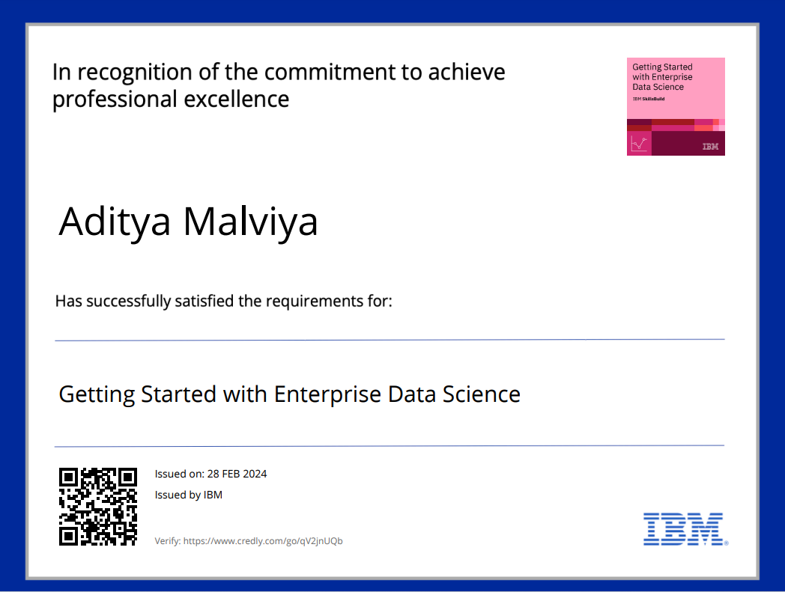
course certificate 1

Slide 12
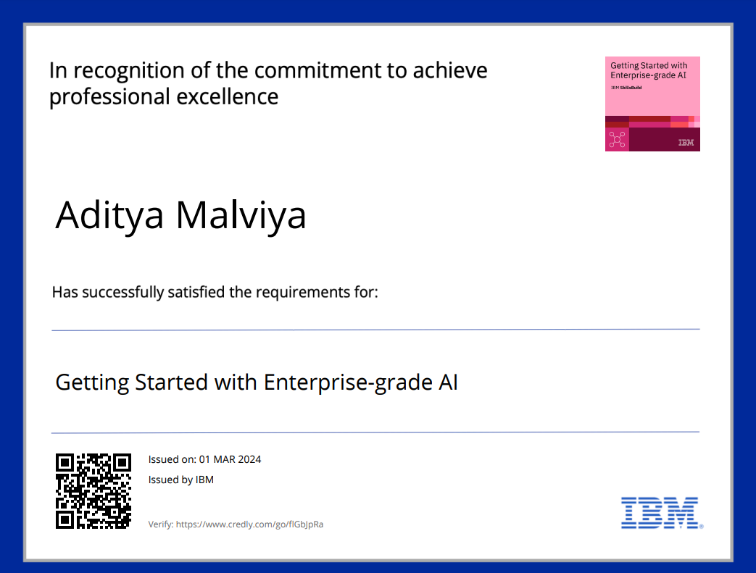
course certificate 2

Slide 13
THANK YOU

